Slide 1
Recidivism Predictive Model
James Beck, Jia Mody

Slide 2
01
Objective
Notes:
James

Slide 3
Objective
Bureau of Justice Stat: 68% of criminals commit repeat offences in 3 years
Comprehensive risk assessment model
Identify potential repeat offenders
Public safety
Support high risk offenders

Slide 4
02
Our Dataset
Notes:
Jia

Slide 5
Our Dataset
Overview
Instances
Attributes
49 attributes, including gender, dependance, drug test positives, etc
Data.gov
Published by U.S. DOJ
25,825 instances, each instance represents one prisoner

Slide 6
Attribute Examples
1
2
3
Prior_Revocations_Parole
Dependents
Prior_Arrest_Episodes_Felony
Have there been previous violations of parole terms?
Number of people dependent on inmate’s income
# of arrests due to felonies

Slide 7
Class Breakdown
2nd Year
Never
1
4567 committed a crime within 2 years of release (17.7%)
3
10,931 did not commit a second crime within 3 years. (42.3%)
2
NO
1st Year
3rd Year
7724 committed a crime within 1 year of release (29.9%)
2613 committed a crime within 3 years of release
(10.1%)
*right skew

Slide 8
03
Pre-processing
Notes:
James

Slide 9
Pre-Processing
1
2
3
4
Missing Values
Derived Class
Normalizing+Changing
Test/Train
Filled in missing values
Created a derived class attribute from 4 potential classes
Normalized quantitative variables + attribute alterations
Created Test/Train split

Slide 10
Missing Values
No attributes were missing >70% values
Replaced missing qualitative values with mode
Replaced missing quantitative values with median (difficulties in WEKA)
Python Script
Notes:
Jia

Slide 11
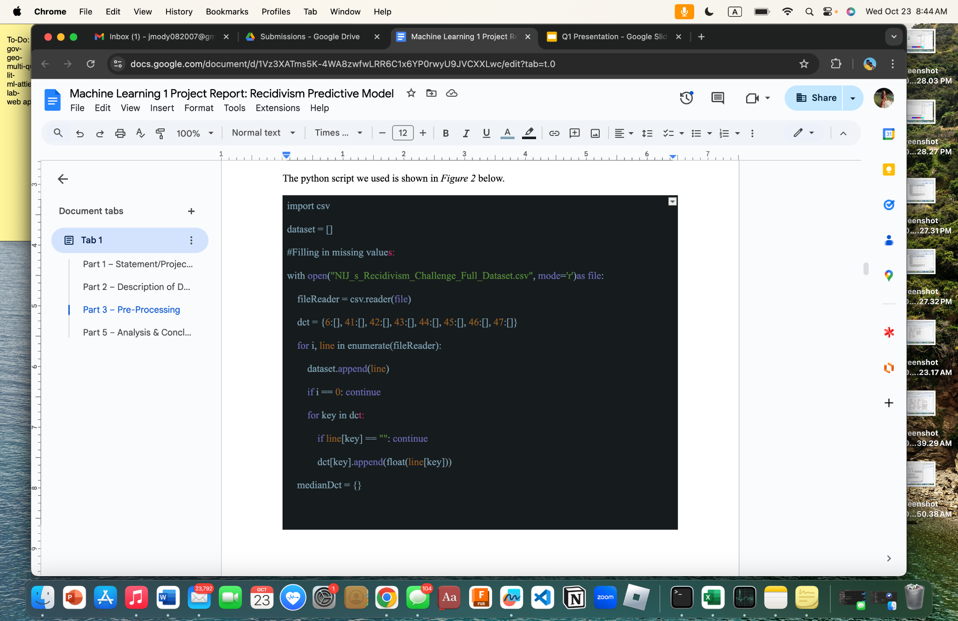
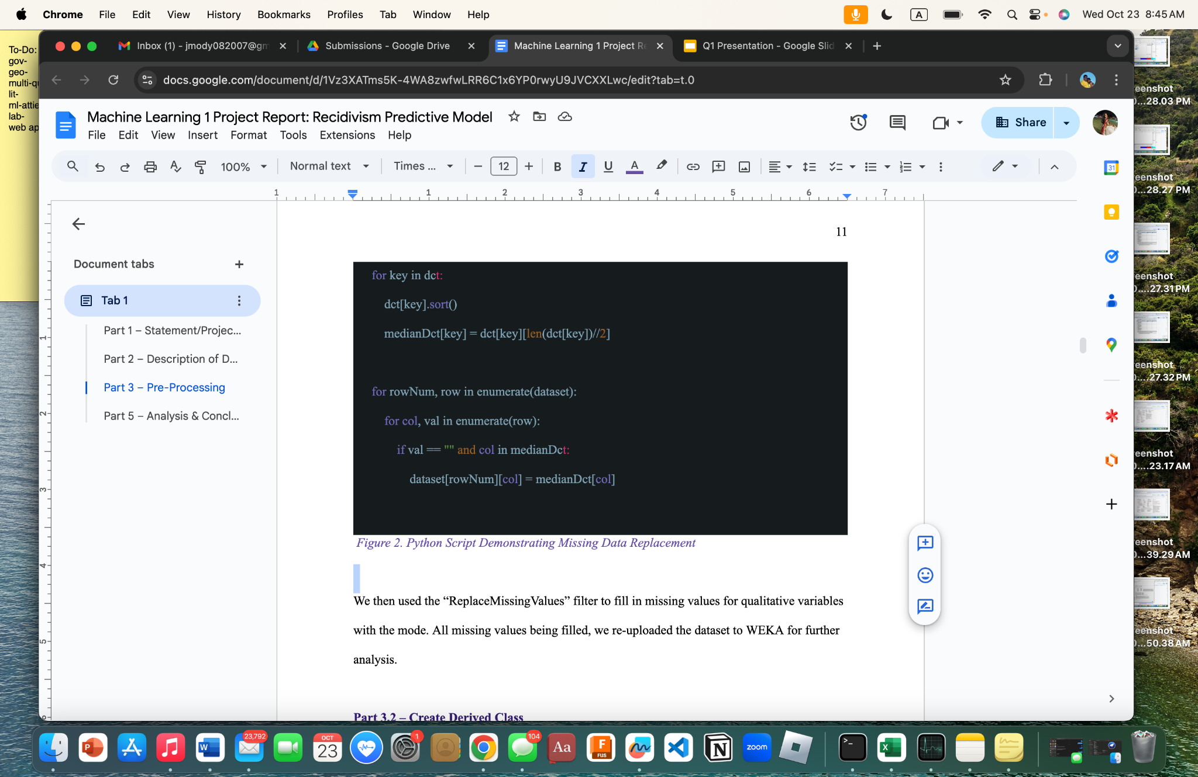

Slide 12
Derived Class
4 potential class attributes
Combined attributes into single class with following labels:
“1” – Arrested within 1 year of release
“2” – Arrested within 2 years of release
“3” – Arrested within 3 years of release
“Never” – No arrest within 3 years of release
Notes:
Jia

Slide 13
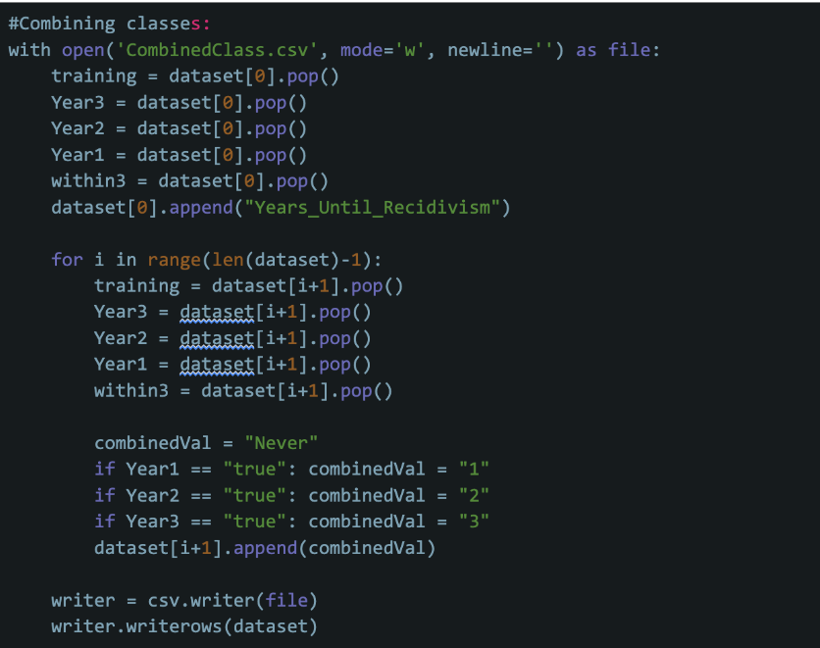

Slide 14
Normalizing and Changing
Normalizing
Altering
WEKA Normalize Filter
Exception: Residence_PUMA
Nominal→Numerical
Notes:
James

Slide 15
Test/Train
Python Script
Originally 70/15/15, but validation was not working well
Changed to 70/30 train test
Notes:
James

Slide 16
Test/Train
Training:
1 yr-5407/18084 (29.9%)
2 yrs-3197/18084 (17.7%)
3 yrs-1829/18084 (10.1%)
Never-7651/18084 (42.3%)
Test:
1 yr-2317/7751 (29.9%)
2 yrs-1370/7751 (17.7%)
3 yrs-784/7751 (10.1%)
Never-3280/7751 (42.3%)
Notes:
James

Slide 17
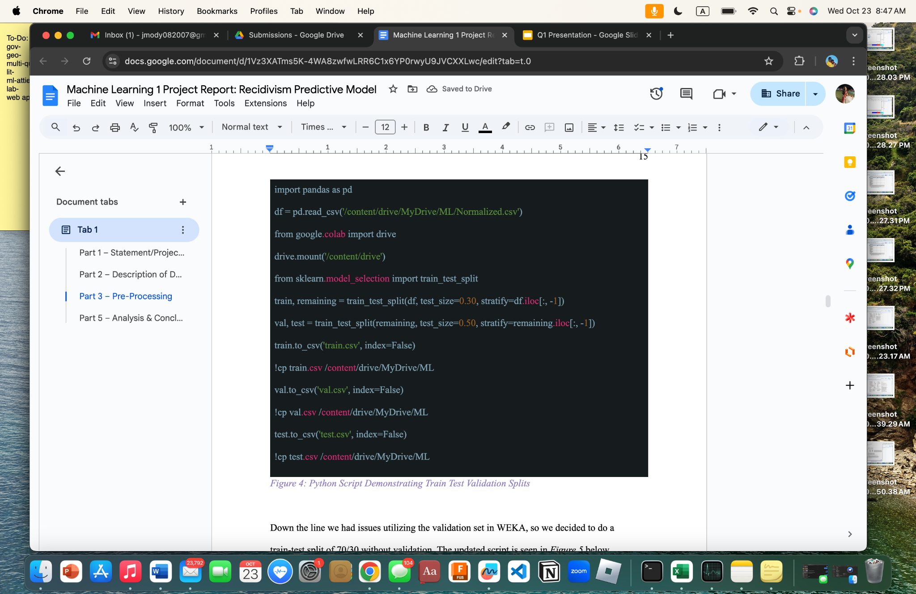
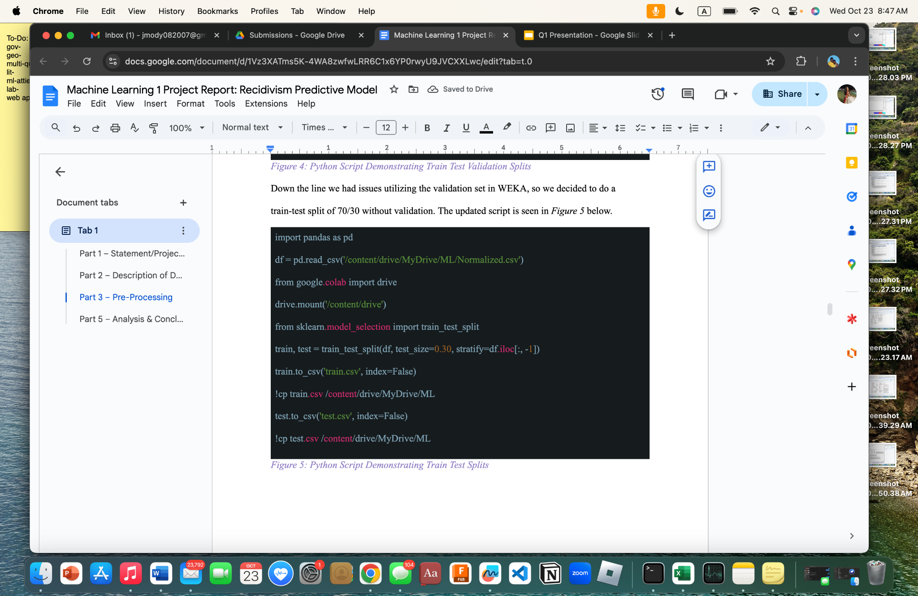

Slide 18
04
Attribute Selection

Slide 19
Attribute Selection
CorrelationAttributeEval
OneRAttributeEval
Self Selection
Cutoff of 0.1
Cutoff of 43.95
9 Attributes
InfoGainAttributeEval
WrapperSubsetEval
Cutoff of 0.25
7 Attributes
Notes:
Jia

Slide 20
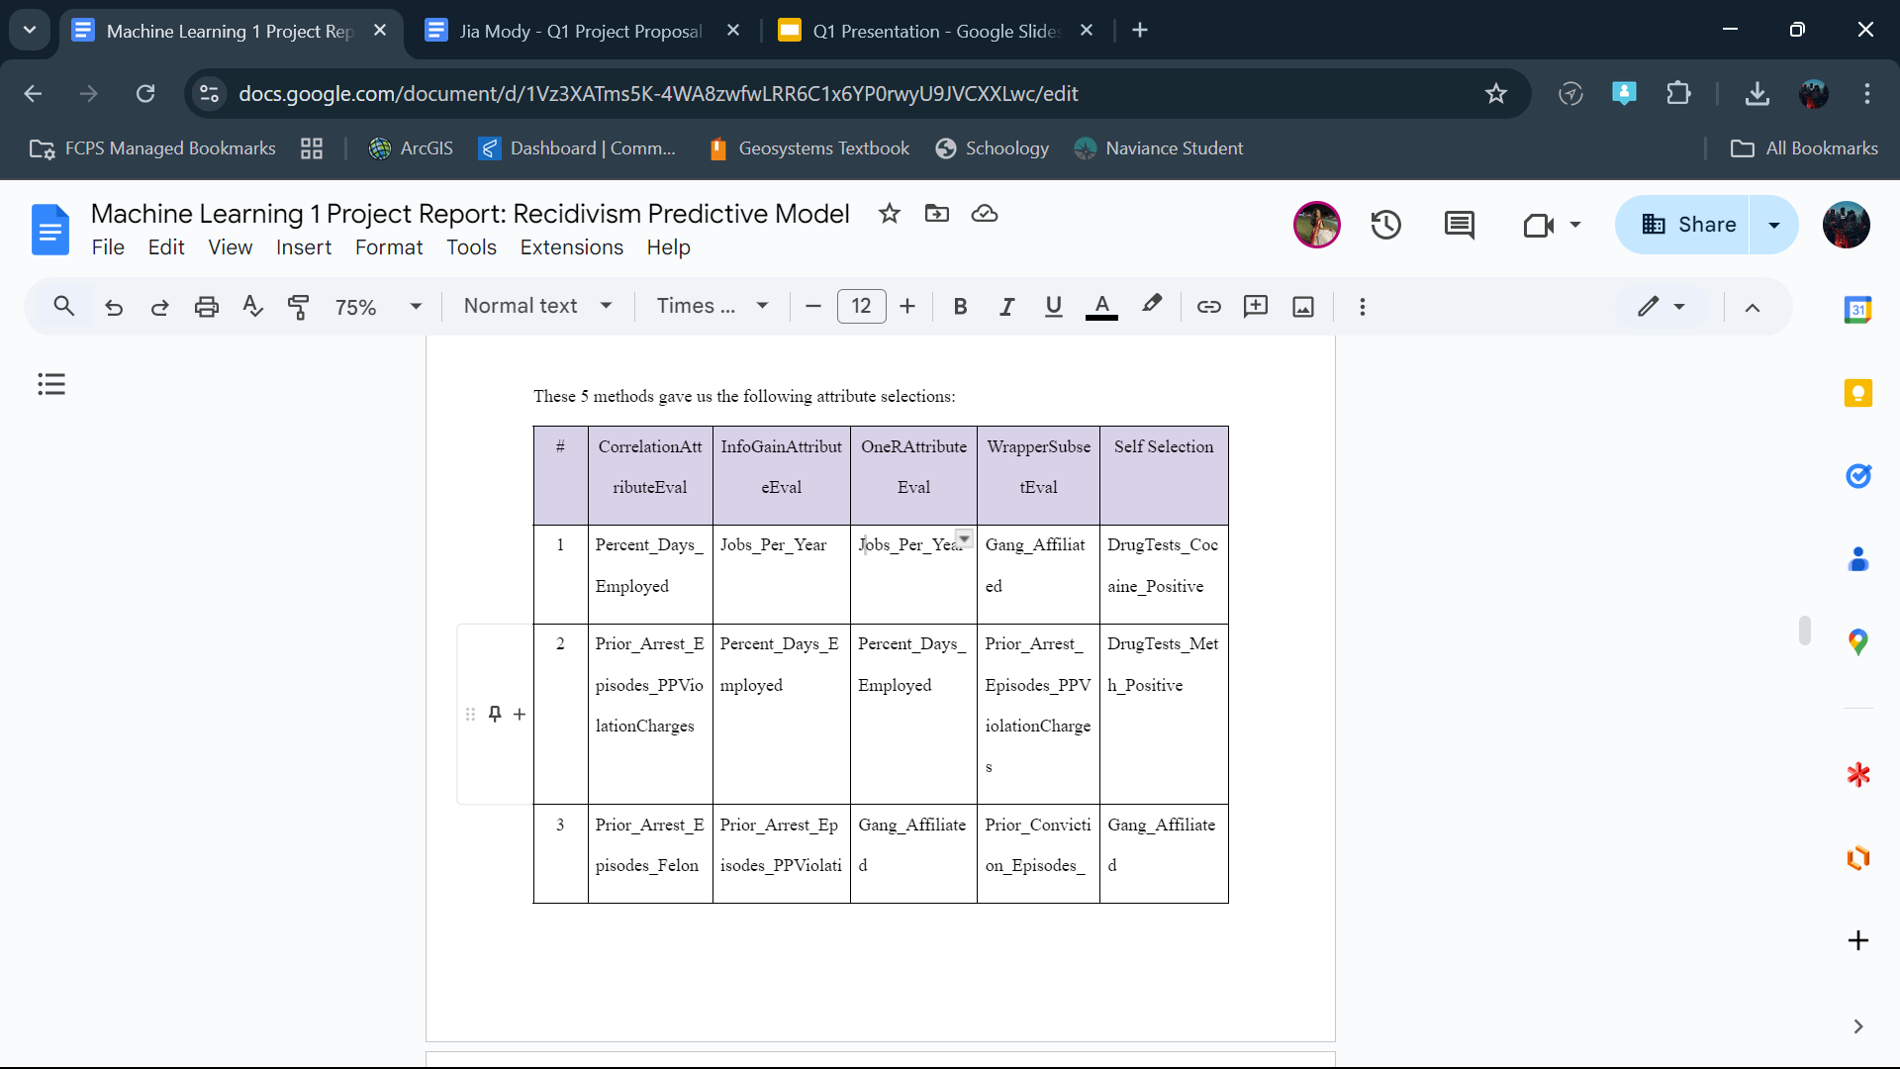
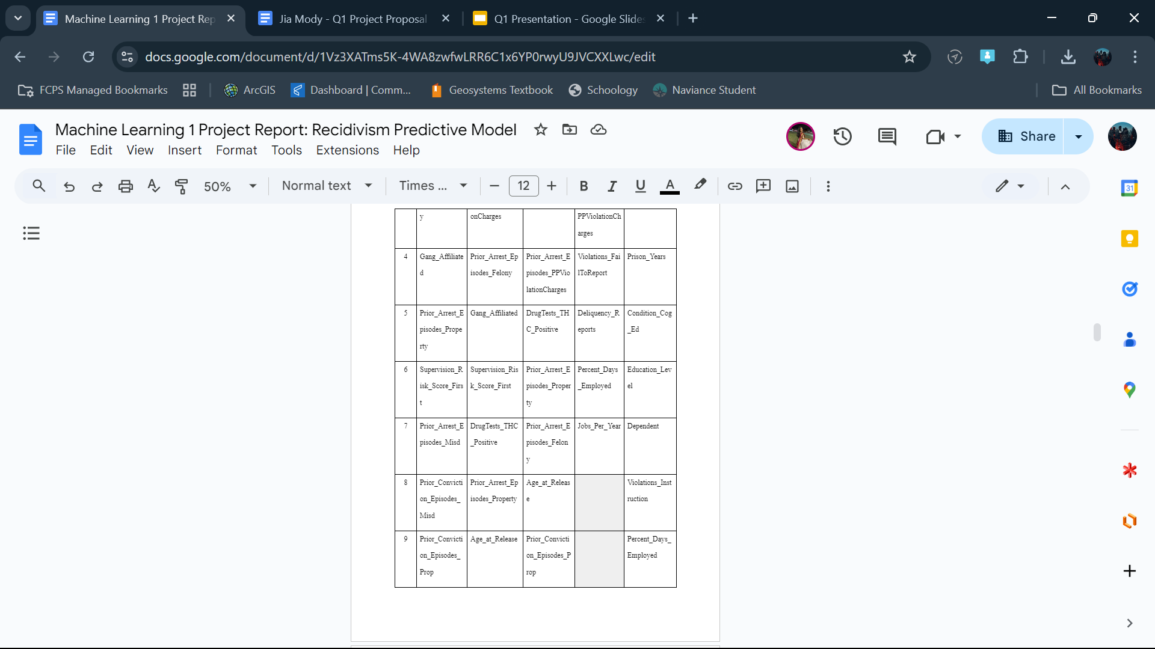

Slide 21
Classification Algorithms
1
2
3
4
J48
Classification via decision trees
NaiveBayes
Baye’s formula
OneR
Rule Based
RandomForest
Decision trees through random subsets of data
Notes:
Jia

Slide 22
Best Model
J48 with attributes selected by WrapperSubsetEval
Accuracy: 54.5
Recall: 0.401

Slide 23
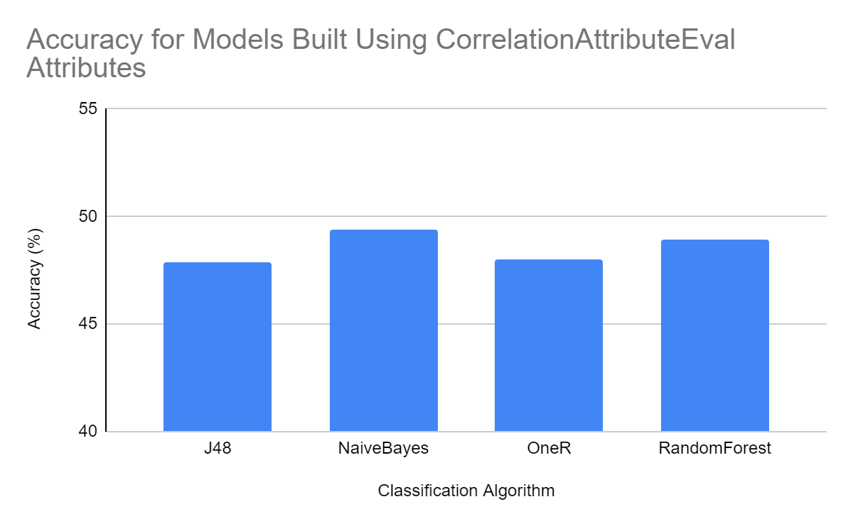
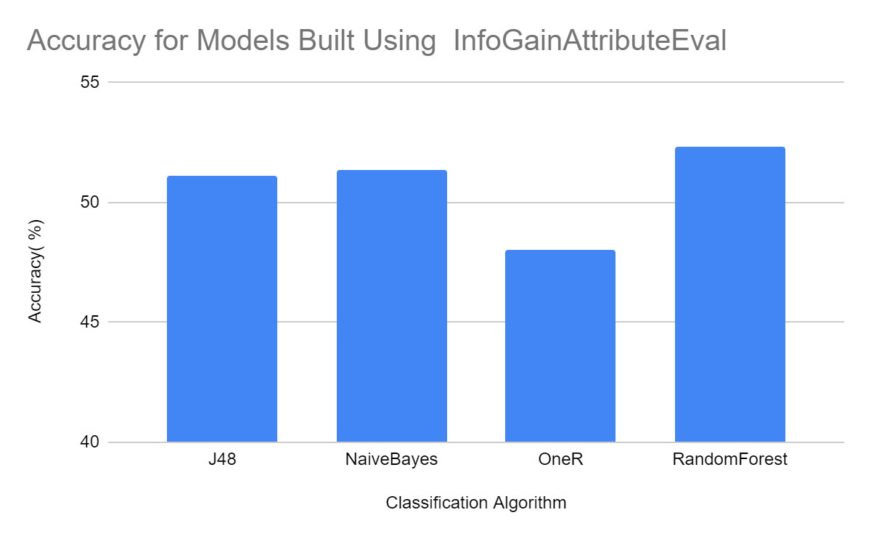
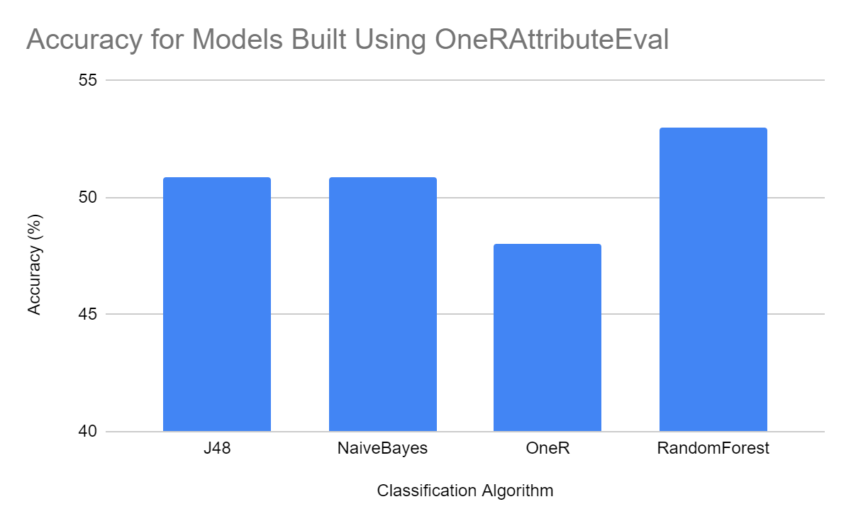
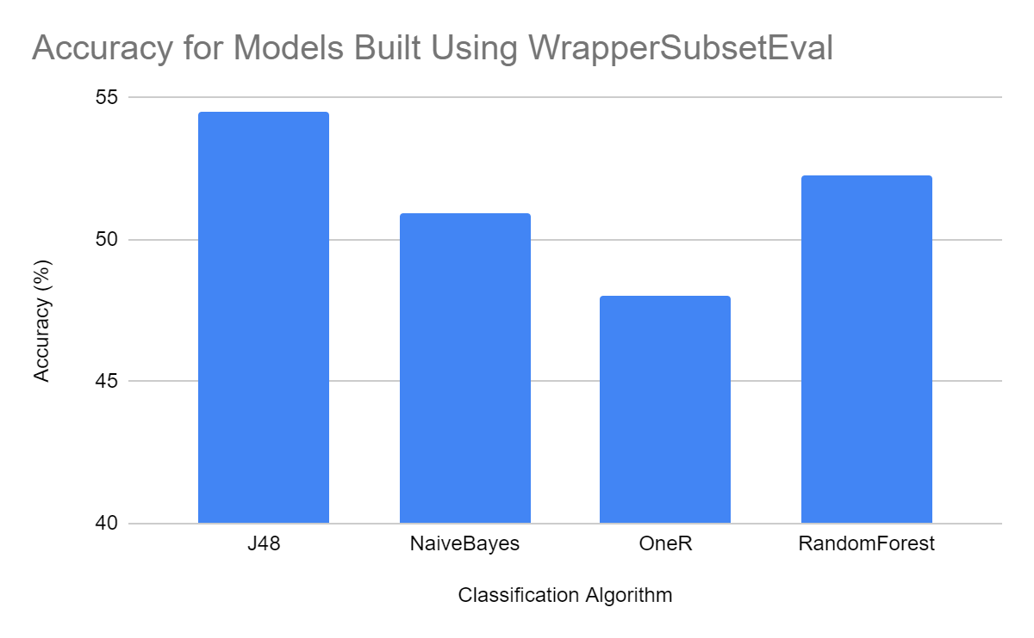
Notes:
Jia

Slide 24
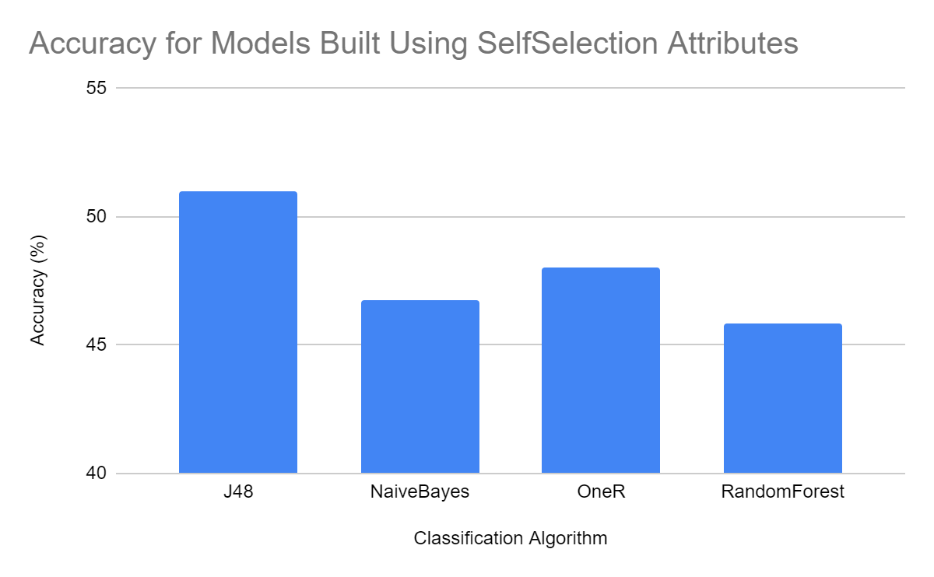
Notes:
Jia

Slide 25
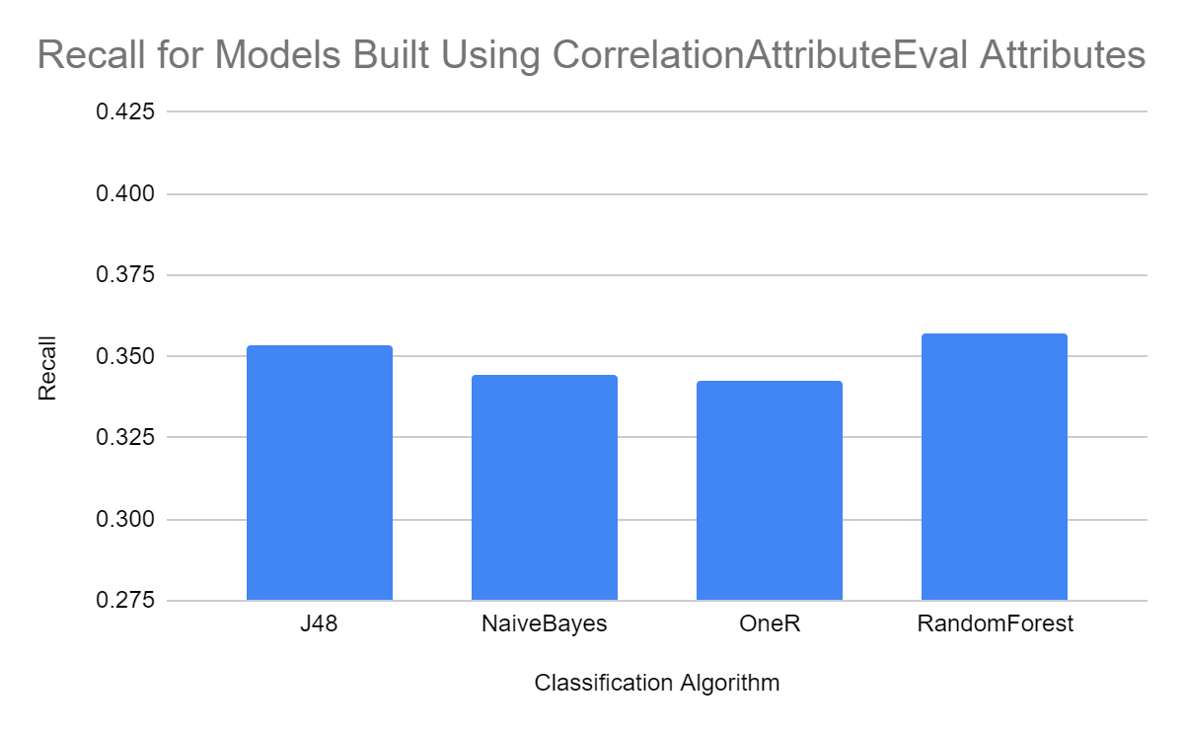
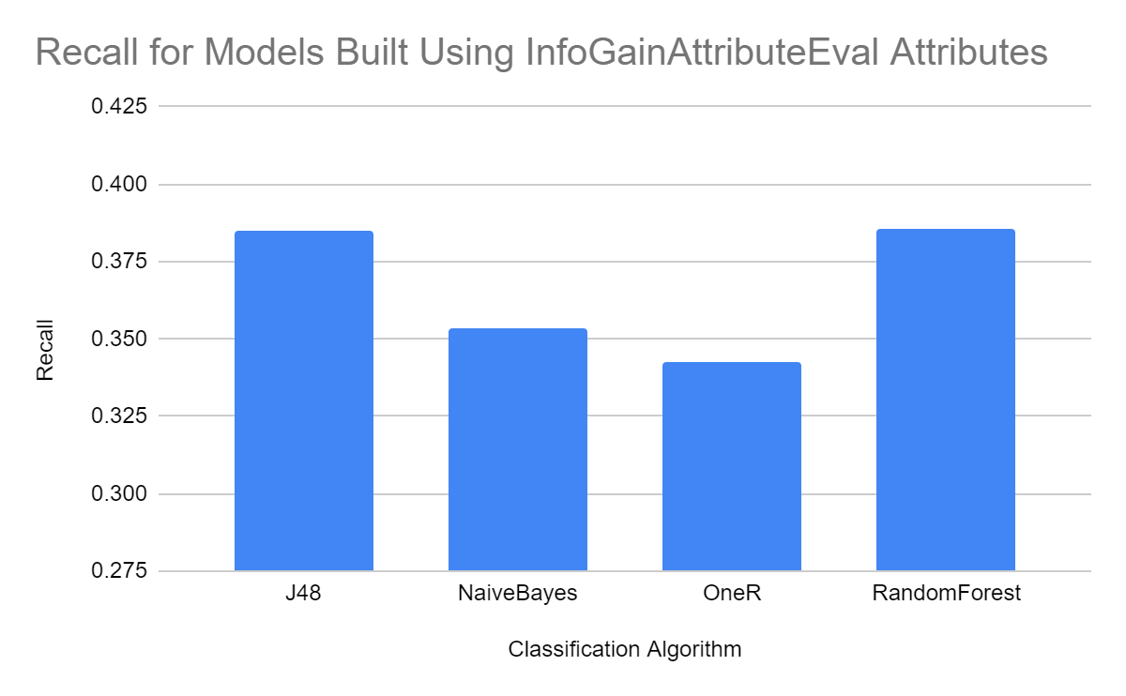
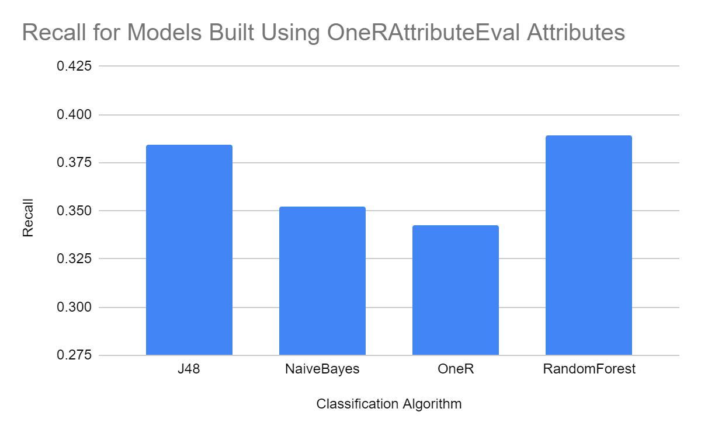
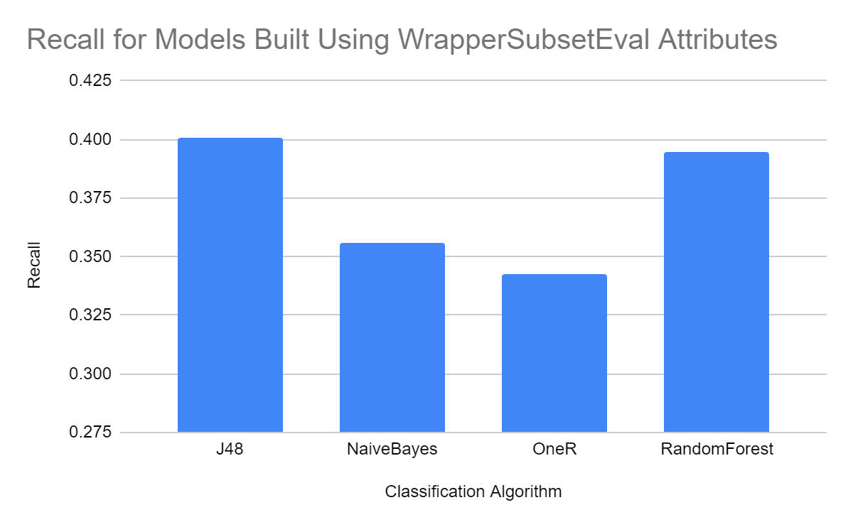
Notes:
James

Slide 26
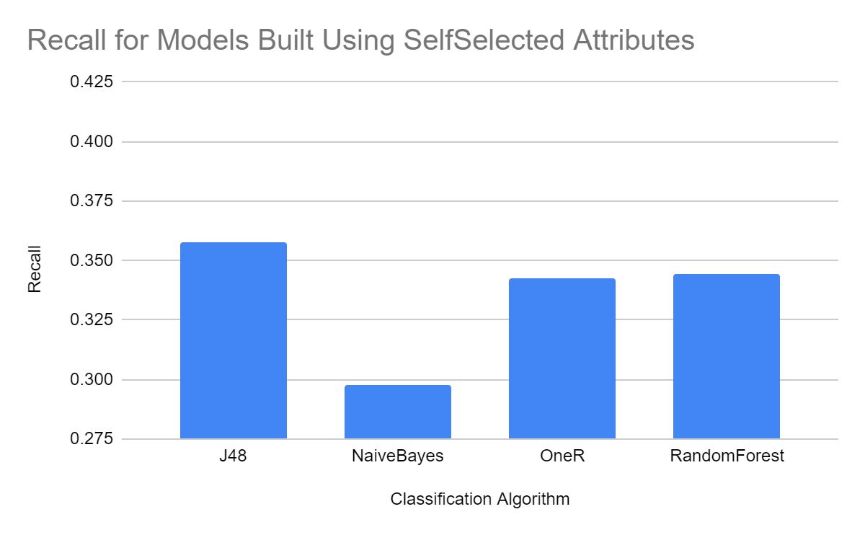
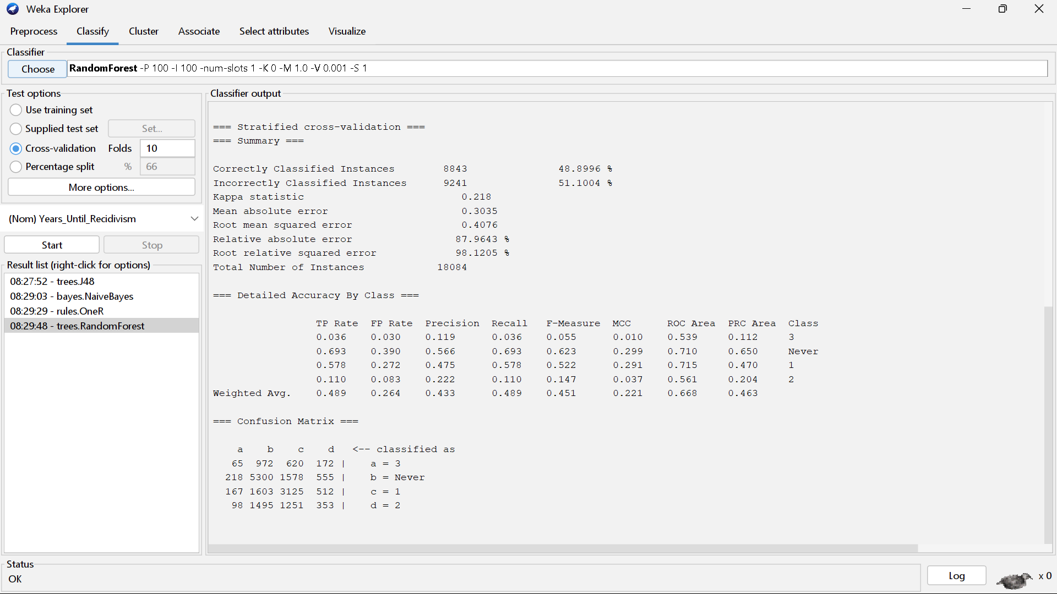
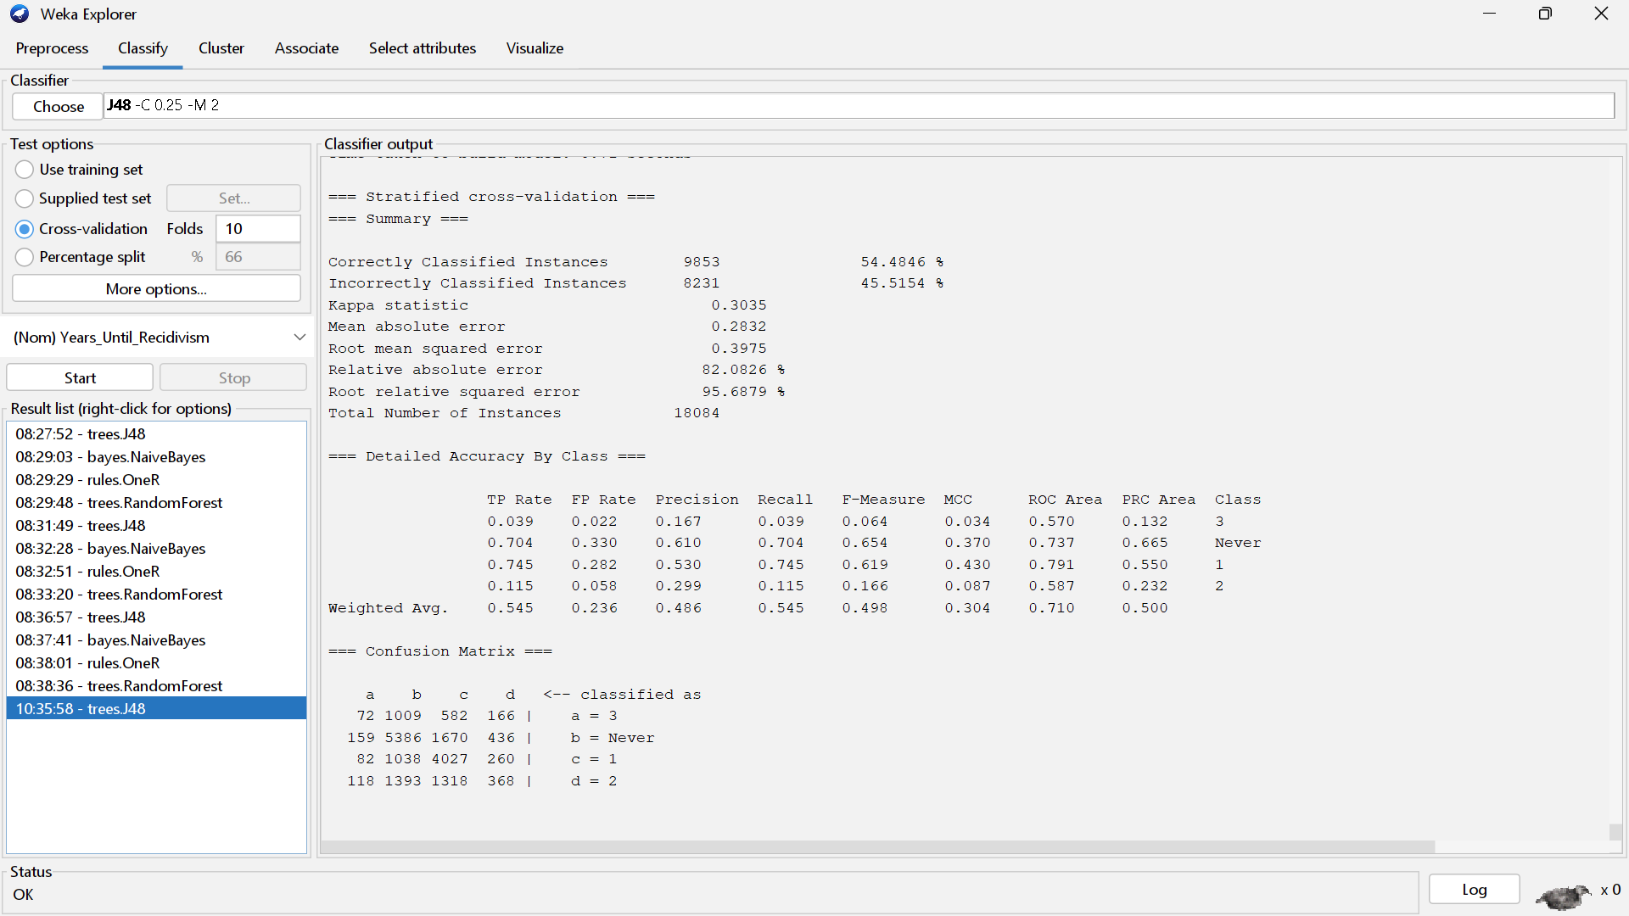
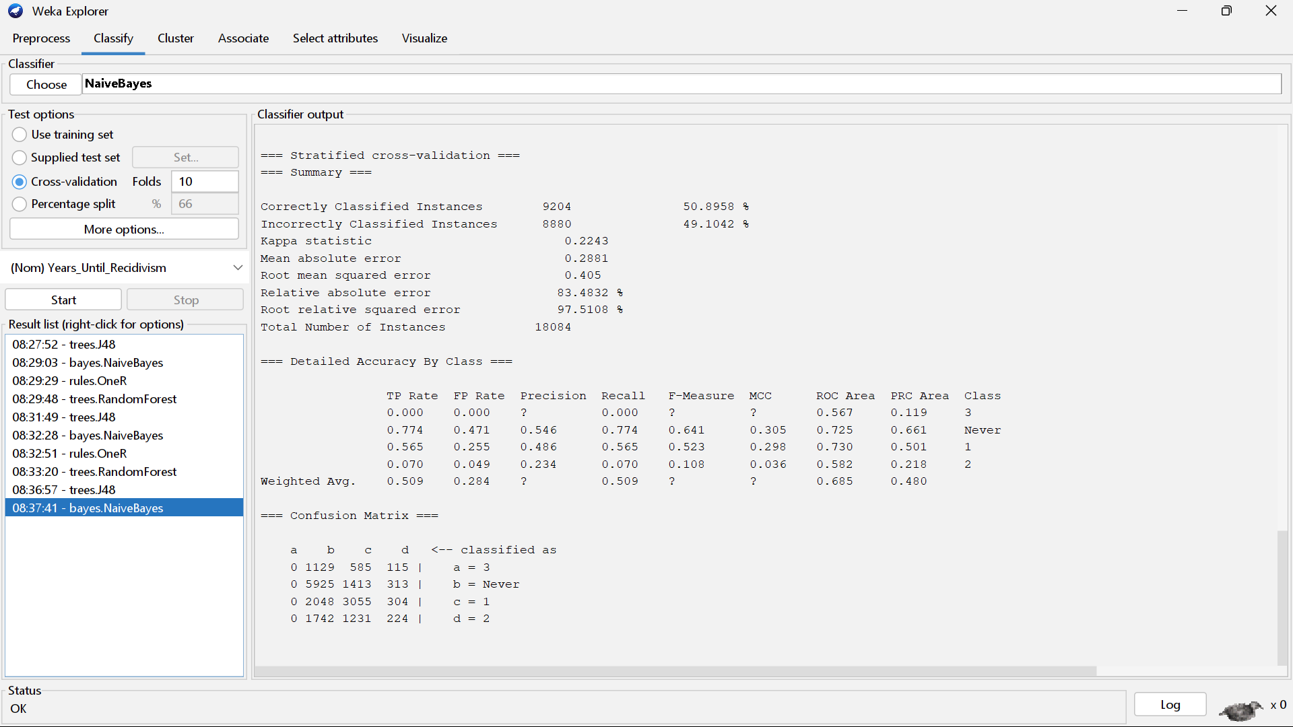
RandomForest CorrelationAttributeEval
J48 WrapperSubsetEval
NaiveBayes OneRAttributeEval
Notes:
James

Slide 27
05
Discussion and Sources of Error

Slide 28
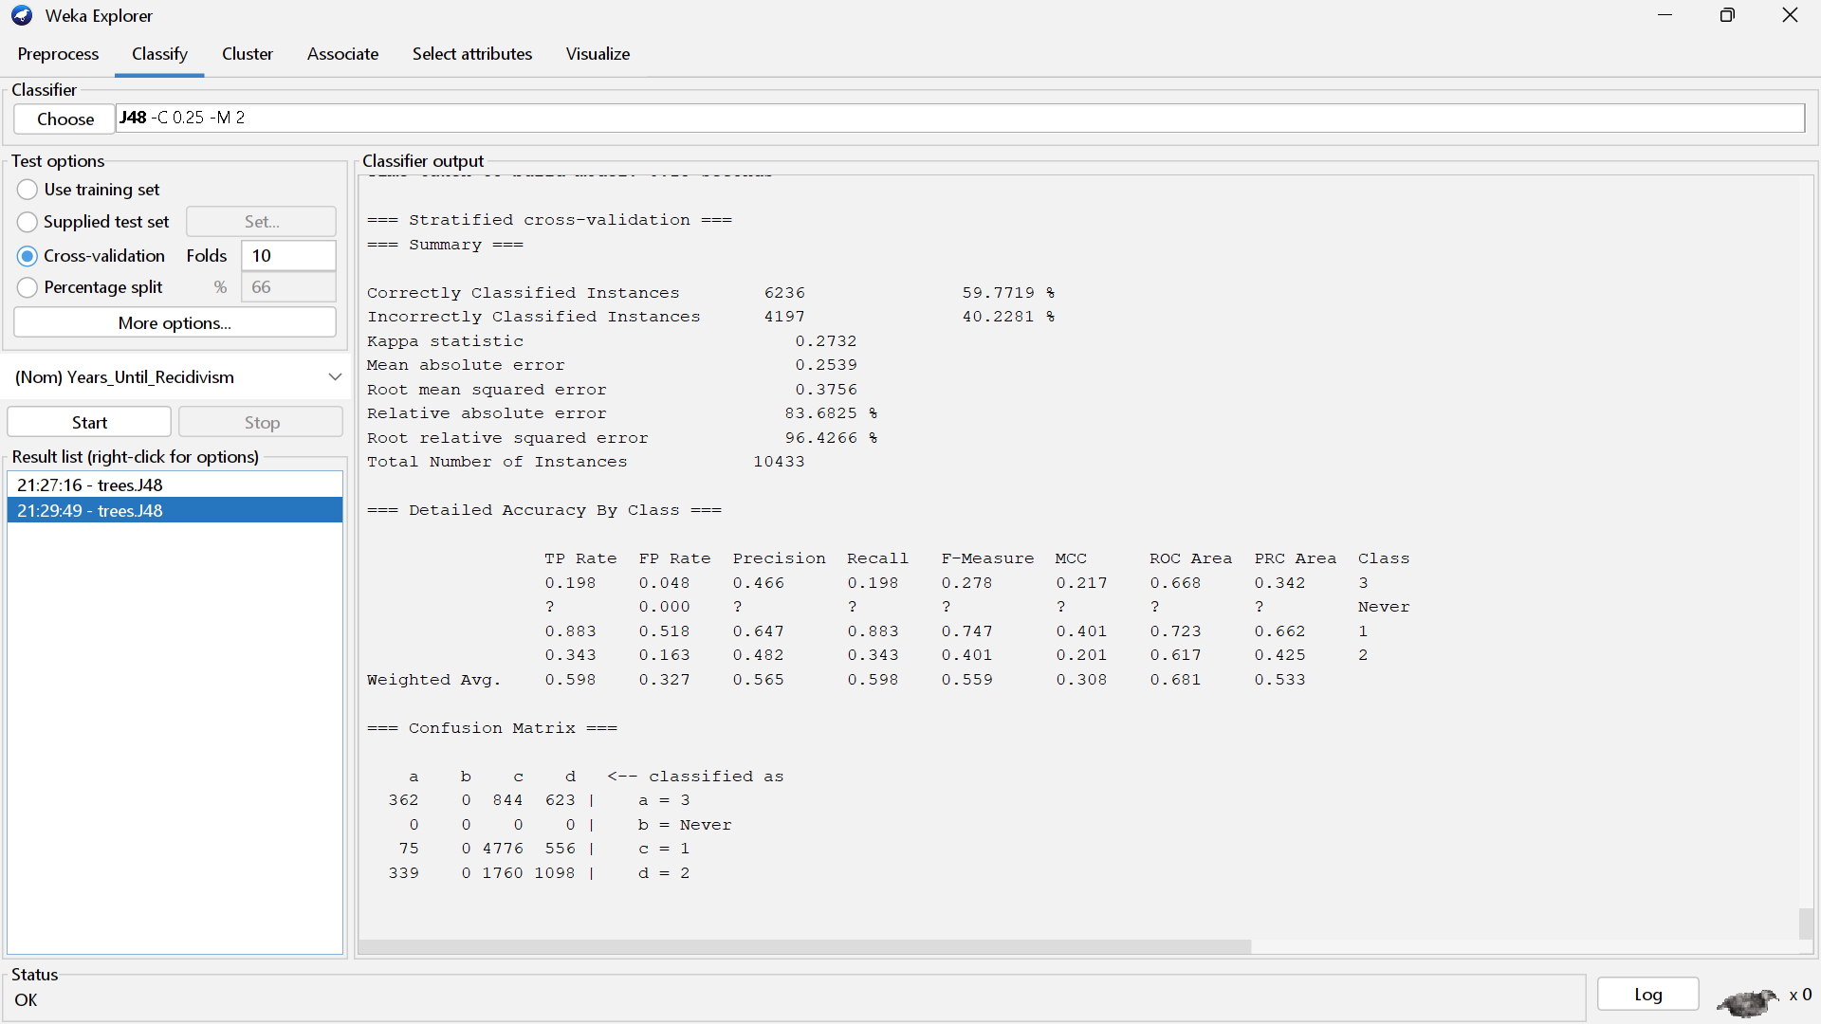
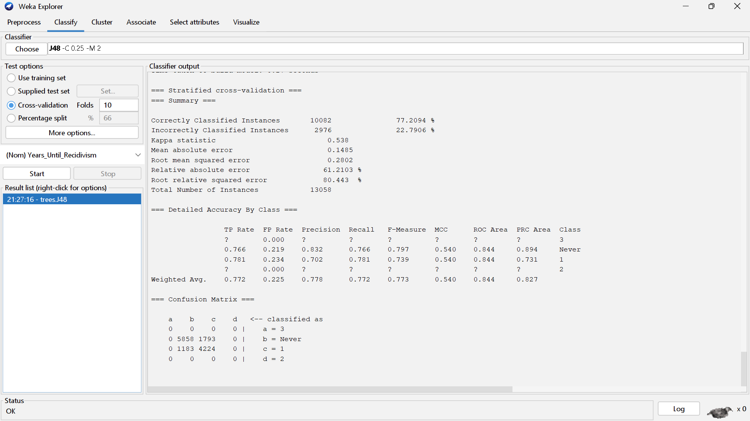
Increasing Accuracy
Removing “Never”
Removing “2” and “3”
Since “Never” was the most predicted, we decided to remove it to see if it improved accuracy. We got a 59.8% accuracy.
These were the least predicted, so we decided to remove them, giving us a 77.2% accuracy.

Slide 29
Error Sources
Error and Discussion
Discussion
Similar characteristics regardless of recidivism year
Not enough data for small categories
Potential to be used in real life, but more analysis is required to build a suitable model

Slide 30
THANKS
Questions?

